Slide 1
OENG1118 Sustainable engineering practice and design
Weeks 3 & 4: Engineering design for sustainability
Phase 3: Preliminary design
Notes:
We’ll start our processes for the Preliminary Design phase. We’ll develop our selected concept by optimising at the system level and designing at the subsystem level.

Slide 2
Course convener
Peter Stasinopoulos
peter.stasinopoulos@rmit.edu.au
57.03.36, City Campus

Slide 3
Engineering design for sustainability: skills
Define sustainable development or regenerative development in the context of your product’s life cycle
Compile non-overlapping sets of design requirements and performance indicators
Develop theoretical targets for the design requirements
Project
Demonstrate each of the 3 skills

Slide 4
Engineering design for sustainability: skills
Incorporate frugal subsystems and processes
Incorporate biomimetic subsystems and processes
Increase eco-efficiency
Increase eco-effectiveness
Identify leverage points using whole system thinking
Follow the optimal design sequence
Optimise the useful lifetime
Project
Demonstrate at least 5 of the skills

Slide 5
Design sequence
Notes:
We’ll use a set of design sequence heuristics to optimise the concept at the system level.

Slide 6
Design sequence
People before hardware Cars: eco-driving, powertrain maintenance, powertrain retrofit
Shell before contents Lighting: building orientation, windows, reflective surfaces, lamps
Application before equipment Work: telecommuting, passenger transport & office equipment
Quality before quantity Lighting: reduce glare, task lighting, ceiling lamps
Passive before active Heating: solar gain, radiant heating, forced-air space heating
Demand before supply Cleaning: prevent dirt, efficient nozzle, rainwater, mains water
(Rocky Mountain Institute 1997)
Notes:
Rocky Mountain Institute (1997) ‘Tunneling through the cost barrier: Why big savings often cost less than small ones’, Rocky Mountain Institute Newsletter, vol. 13, no. 2, p. 3. Available at http://www.rmi.org/images/other/Newsletter/NLRMIsum97.pdf. Accessed 6 June 2007.

Slide 7
Design sequence
People before hardware Cars: eco-driving, powertrain maintenance, powertrain retrofit
Shell before contents Lighting: building orientation, windows, reflective surfaces, lamps
Application before equipment Work: telecommuting, passenger transport & office equipment
Quality before quantity Lighting: reduce glare, task lighting, ceiling lamps
Passive before active Heating: solar gain, radiant heating, forced-air space heating
Demand before supply Cleaning: prevent dirt, efficient nozzle, rainwater, mains water
(Rocky Mountain Institute 1997)
Notes:
Rocky Mountain Institute (1997) ‘Tunneling through the cost barrier: Why big savings often cost less than small ones’, Rocky Mountain Institute Newsletter, vol. 13, no. 2, p. 3. Available at http://www.rmi.org/images/other/Newsletter/NLRMIsum97.pdf. Accessed 6 June 2007.

Slide 8
Design sequence
People before hardware Cars: eco-driving, powertrain maintenance, powertrain retrofit
Shell before contents Lighting: building orientation, windows, reflective surfaces, lamps
Application before equipment Work: telecommuting, passenger transport & office equipment
Quality before quantity Lighting: reduce glare, task lighting, ceiling lamps
Passive before active Heating: solar gain, radiant heating, forced-air space heating
Demand before supply Cleaning: prevent dirt, efficient nozzle, rainwater, mains water
(Rocky Mountain Institute 1997)
Notes:
Rocky Mountain Institute (1997) ‘Tunneling through the cost barrier: Why big savings often cost less than small ones’, Rocky Mountain Institute Newsletter, vol. 13, no. 2, p. 3. Available at http://www.rmi.org/images/other/Newsletter/NLRMIsum97.pdf. Accessed 6 June 2007.

Slide 9
Design sequence
People before hardware Cars: eco-driving, powertrain maintenance, powertrain retrofit
Shell before contents Lighting: building orientation, windows, reflective surfaces, lamps
Application before equipment Work: telecommuting, passenger transport & office equipment
Quality before quantity Lighting: reduce glare, task lighting, ceiling lamps
Passive before active Heating: solar gain, radiant heating, forced-air space heating
Demand before supply Cleaning: prevent dirt, efficient nozzle, rainwater, mains water
(Rocky Mountain Institute 1997)
Notes:
Rocky Mountain Institute (1997) ‘Tunneling through the cost barrier: Why big savings often cost less than small ones’, Rocky Mountain Institute Newsletter, vol. 13, no. 2, p. 3. Available at http://www.rmi.org/images/other/Newsletter/NLRMIsum97.pdf. Accessed 6 June 2007.

Slide 10
Design sequence
People before hardware Cars: eco-driving, powertrain maintenance, powertrain retrofit
Shell before contents Lighting: building orientation, windows, reflective surfaces, lamps
Application before equipment Work: telecommuting, passenger transport & office equipment
Quality before quantity Lighting: reduce glare, task lighting, ceiling lamps
Passive before active Heating: solar gain, radiant heating, forced-air space heating
Demand before supply Cleaning: prevent dirt, efficient nozzle, rainwater, mains water
(Rocky Mountain Institute 1997)
Notes:
Rocky Mountain Institute (1997) ‘Tunneling through the cost barrier: Why big savings often cost less than small ones’, Rocky Mountain Institute Newsletter, vol. 13, no. 2, p. 3. Available at http://www.rmi.org/images/other/Newsletter/NLRMIsum97.pdf. Accessed 6 June 2007.

Slide 11
Design sequence
People before hardware Cars: eco-driving, powertrain maintenance, powertrain retrofit
Shell before contents Lighting: building orientation, windows, reflective surfaces, lamps
Application before equipment Work: telecommuting, passenger transport & office equipment
Quality before quantity Lighting: reduce glare, task lighting, ceiling lamps
Passive before active Heating: solar gain, radiant heating, forced-air space heating
Demand before supply Cleaning: prevent dirt, efficient nozzle, rainwater, mains water
(Rocky Mountain Institute 1997)
Notes:
Rocky Mountain Institute (1997) ‘Tunneling through the cost barrier: Why big savings often cost less than small ones’, Rocky Mountain Institute Newsletter, vol. 13, no. 2, p. 3. Available at http://www.rmi.org/images/other/Newsletter/NLRMIsum97.pdf. Accessed 6 June 2007.

Slide 12
Design sequence
People before hardware Cars: eco-driving, powertrain maintenance, powertrain retrofit
Shell before contents Lighting: building orientation, windows, reflective surfaces, lamps
Application before equipment Work: telecommuting, passenger transport & office equipment
Quality before quantity Lighting: reduce glare, task lighting, ceiling lamps
Passive before active Heating: solar gain, radiant heating, forced-air space heating
Demand before supply Cleaning: prevent dirt, efficient nozzle, rainwater, mains water
(Rocky Mountain Institute 1997)
Notes:
Rocky Mountain Institute (1997) ‘Tunneling through the cost barrier: Why big savings often cost less than small ones’, Rocky Mountain Institute Newsletter, vol. 13, no. 2, p. 3. Available at http://www.rmi.org/images/other/Newsletter/NLRMIsum97.pdf. Accessed 6 June 2007.

Slide 13
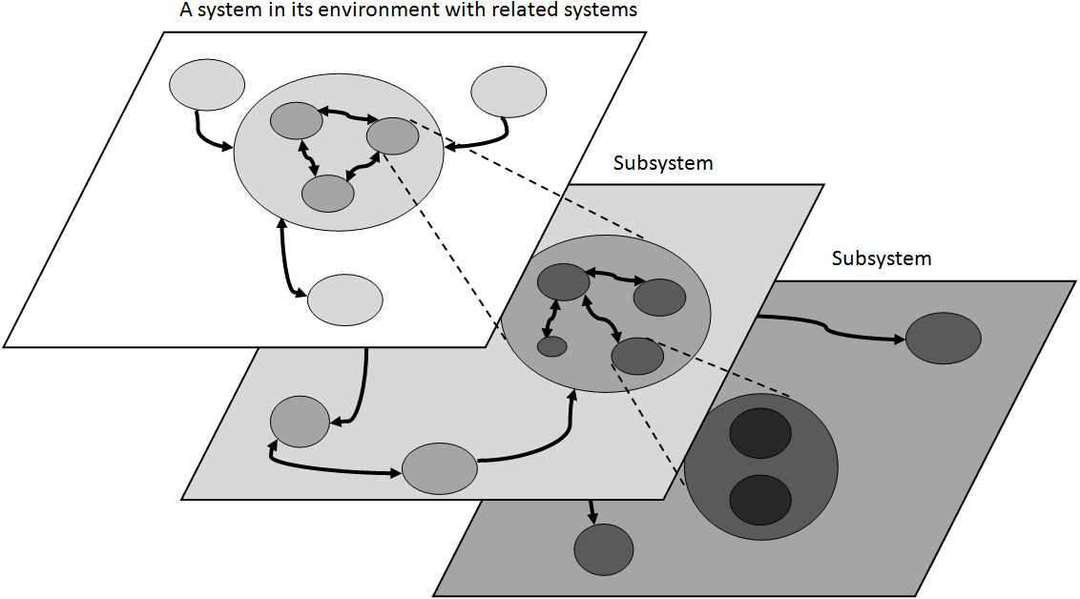
Design sequence: demand before supply
If many interactions originate at a particular subsystem, then start optimisation at that subsystem and then work outwards
If resources flow upstream to downstream, then optimise subsystems from downstream to upstream
The impacts of subsystems in series compound, not sum
(Adcock n.d.)
Notes:
Adcock, R. (n.d.) Principles and practices of Systems Engineering, presentation, Cranfield University, p. 8. Available at http://www.incose.org.uk/Downloads/AA01.1.4_Principles%20&%20practices%20of%20SE.pdf. Accessed 27 March 2008.

Slide 14
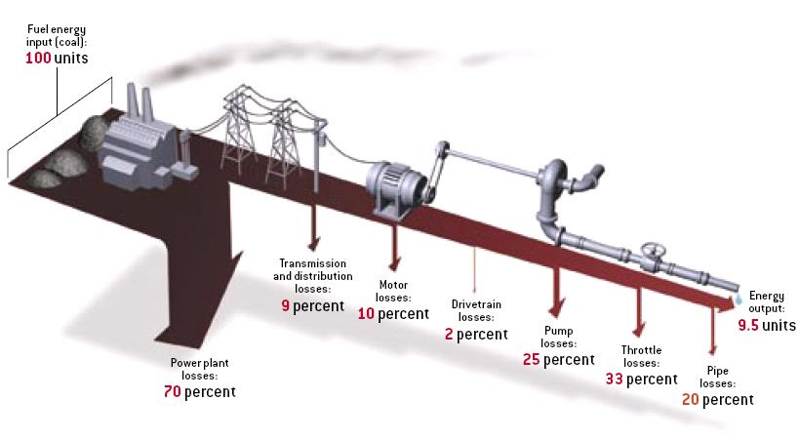
Design sequence: demand before supply
Example: energy
(Lovins 2005)
Notes:
Reducing ‘Energy output’ by 1 unit eliminates 10.5 (= 100/9.5) units of ‘Fuel energy input’. Next, reducing ‘Pipe losses’ by 1 unit eliminates a further 8.3 units; ‘Throttle losses’, 5.5 units; ‘Pump losses’, 4.2 units; and so on up to ‘Power plant losses’, which eliminates 1 unit of ‘Fuel energy input’. The result is that reducing energy losses by 1 unit in each subsystem, or 8 units in total, eliminates 40 units of ‘Fuel energy input’.
Lovins, A.B. (2005) ‘More profit with less carbon’, Scientific American, September, p. 76.

Slide 15
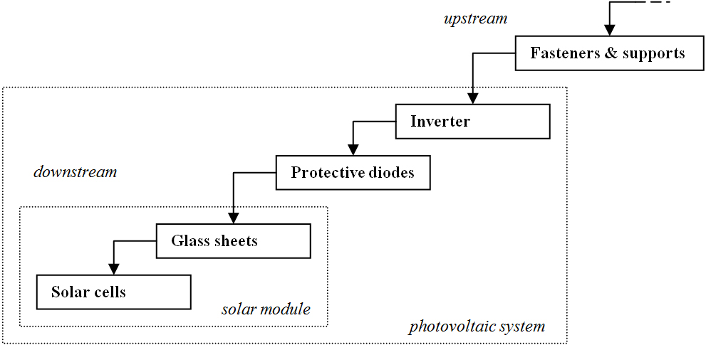
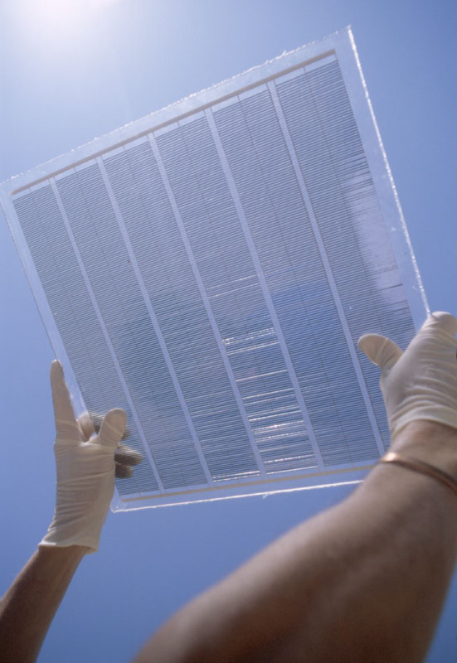
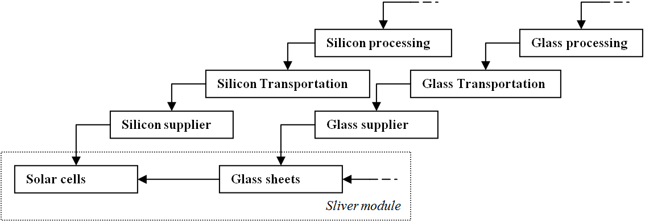
Design sequence: demand before supply
Example: materials
(Centre for Sustainable Energy Systems)

Slide 16
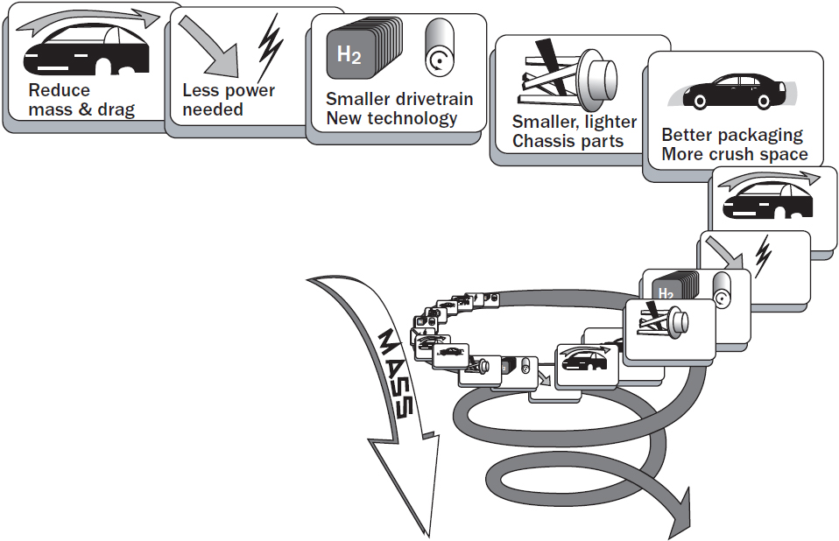
Design sequence: demand before supply
Example: energy & materials
(Adapted from Brylawski and Lovins 1998)
Notes:
Brylawski, M.M. and Lovins, A.B. (1998) Advanced composites: The car is at the crossroads, RMI. Available at http://www.rmi.org/images/other/Trans/T98-01_CarAtCrossroads.pdf. Accessed 19 January 2006

Slide 17
Design sequence: demand before supply
Example: energy & materials
Computing server
Leverage: substitute 1 x 75W processor with 2 x 7-15W processor
No cooling fans or heat sink
Smaller package > blade shape
Less space cooling
(Los Alamos National Laboratory 2001; Transmeta Corporation 2002)
Notes:
Los Alamos National Laboratory (2001) Supercomputing in small spaces, Los Alamos National Laboratory. Available at http://public.lanl.gov/radiant/pubs/sss/sc2001-pamphlet.pdf. Accessed 9 January 2005.
Transmeta Corporation (2002) Transmeta's 1 GHz crusoe processor enables fast, high density blade server from RLX Technologies, Transmeta Corpration. Available at http://investor.transmeta.com/ReleaseDetail.cfm?ReleaseID=97691. Accessed 30 March 2007.

Slide 18
Design sequence
Skill: Follow the optimal design sequence
Activity
Identify 1 optimisation in the system for each optimisation sequence
Apply each optimisation to the system
Identify 1-2 resource-transmission paths in the system
Optimise resource use along the path(s)

Slide 19
Design for lifetime
Notes:
We’ll use a strategy called design for lifetime to optimise the concept at the subsystem and components levels.

Slide 20
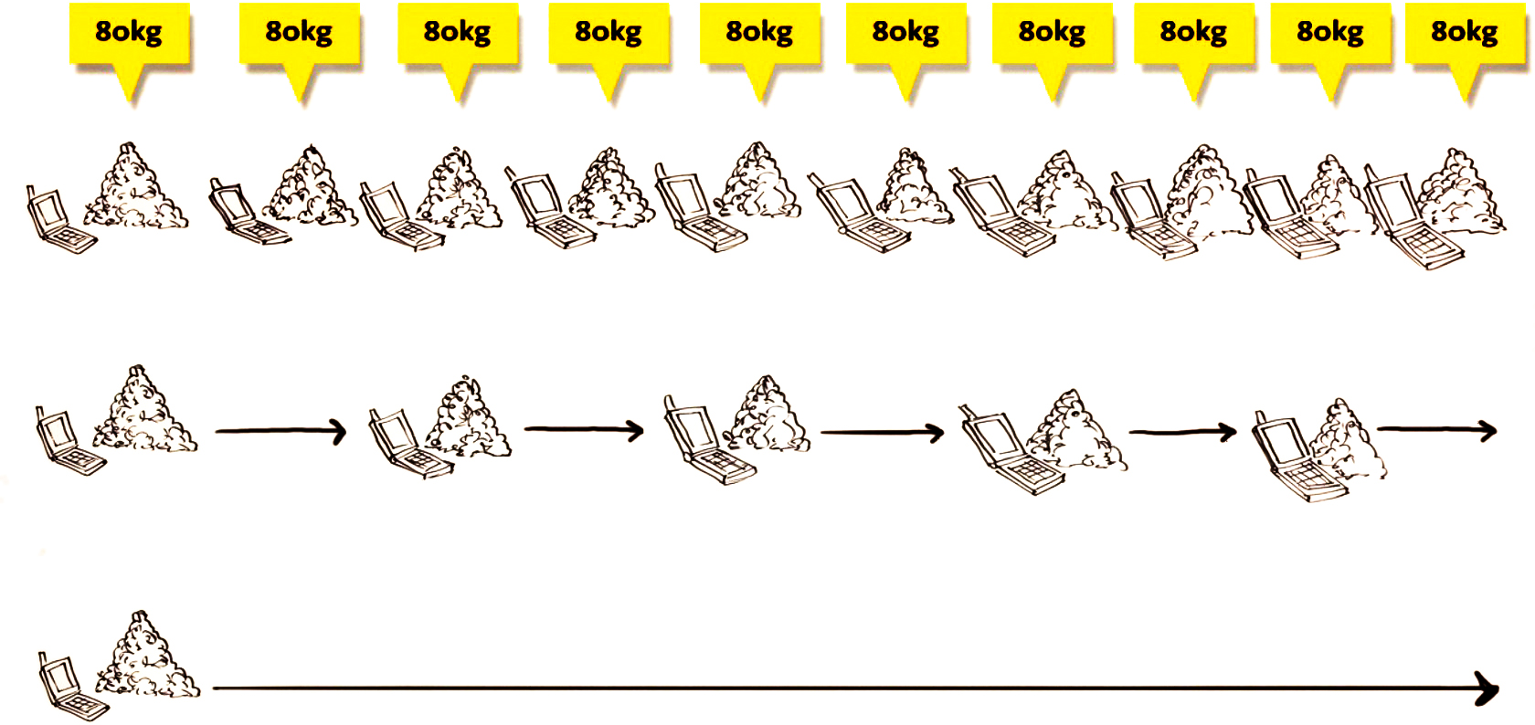
Design for lifetime
Higher durability enables:
more services per resource
fewer resources per service
Design for the optimal useful lifetime of each component
Enlist users in extending lifetime
(Autodesk 2011)

Slide 21
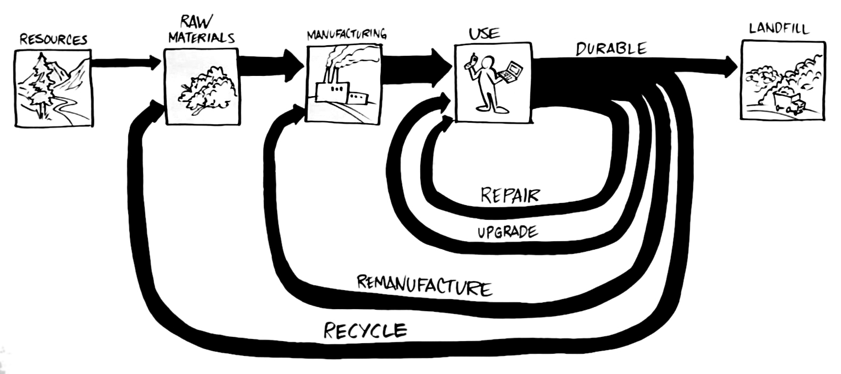
Design for lifetime
Biological nutrients
Products of consumption
Products of service
Design for the optimal end-of-life strategy of each component
Enlist suppliers, manufacturer, users, collectors, etc. in closing loops
(Autodesk 2011)
Technical nutrients

Slide 22
Design for lifetime
Skill: Optimise the useful lifetime
Activity
Determine the optimal lifetime and end-of-life strategy for each major component in the system
Example – multifunction device:
Print materials:
6 month (minimum user expectation) to 10 years (the expected useful lifetime)
Remanufacture
Hardware:
10 years (the expected useful lifetime)
Reuse
Identify 1 appropriate design-for-lifetime feature for each major component in the system

Slide 23
Thanks!
Notes:
We’ve now concluded our processes for the Preliminary Design phase. We developed our selected concept by optimising at the system level and designing at the subsystem level. Next, we’ll start our Review processes.

Slide 24
Assessment tasks
Week 1-2
Week 3 ________ ________ ________
Week 4 ________ ________ ________
… | …
Week 11 ________ ________ ________
Project
Project
Project-based learning
Lectures: learn fundamental content and skills
Private: apply content and skills to your group project
Tutorials: get feedback on your group project
Private: revise group project based on feedback
Project
Project

Slide 25
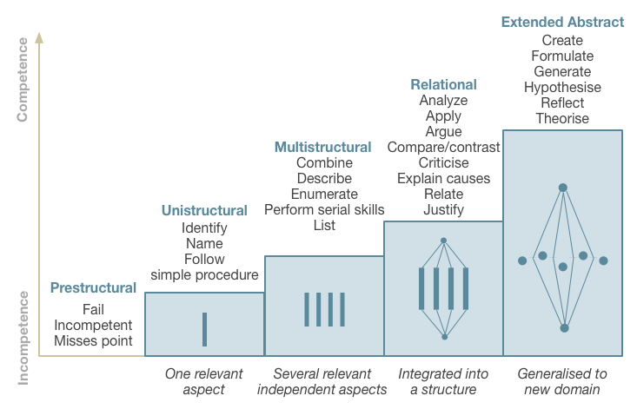
Assessment standards
SOLO taxonomy
Video (4 min)
Text (100 words)
Source: The Australian National University 2014, Unravelling Complexity, The Australian National University, Canberra. http://vc-courses.anu.edu.au/uc/home, viewed 4 March 2014.

